Slide 1


MAP Lab
LAB 3 : Use Push Button to Control LED
Kshitij Hemant Gurjar (SY M.Tech VLSI)
Prof. Y.M. Vaidya
Swapnil Phalke (SY M.Tech VLSI)
MAP Lab

Slide 2
AIM
In this tutorial, we will learn how to use on-board Push buttons of TM4C123G TIVA launchpad to control onboard LEDs. Firstly, you should know how to use GPIO pins of TM4C123G6PM microcontroller as digital output pins
LAB 1 Introduction to TM4C123
Kshitij Hemant Gurjar (SY M.Tech VLSI)
Prof. Y.M. Vaidya
Swapnil Phalke (SY M.Tech VLSI)
MAP Lab

Slide 3
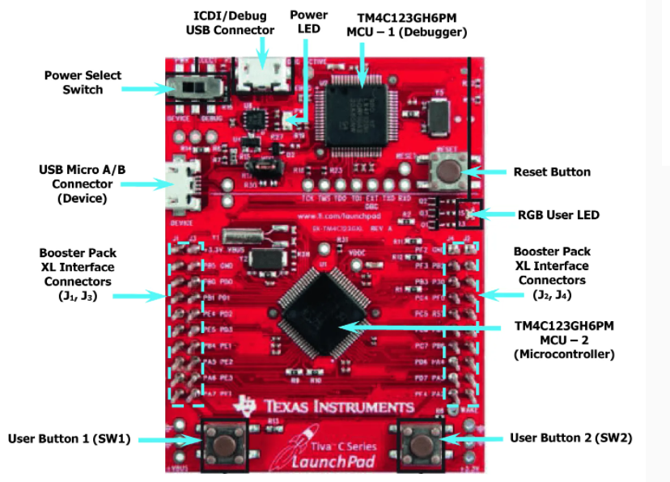
Kshitij Hemant Gurjar (SY M.Tech VLSI)
Prof. Y.M. Vaidya
Swapnil Phalke (SY M.Tech VLSI)
MAP Lab

Slide 4
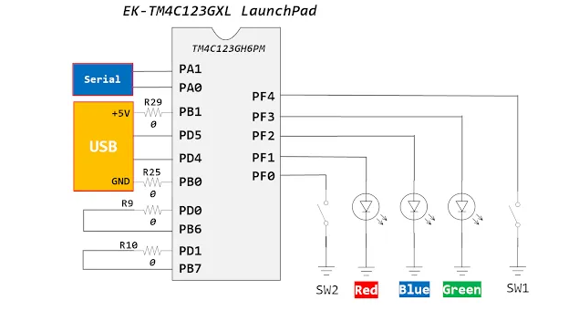
Kshitij Hemant Gurjar (SY M.Tech VLSI)
Prof. Y.M. Vaidya
Swapnil Phalke (SY M.Tech VLSI)
MAP Lab

Slide 5
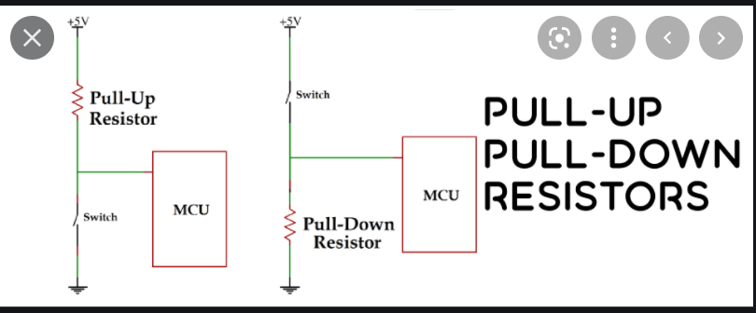
There is no pull-up resistor available with switch-one and switch-two. But the good thing is that the TM4C1235G series microcontroller has internal pull-up and pull-down registers associated with each port. We can configure these resistors using a respective GPIO port register. In the programming section, we will see how to configure this register.
Kshitij Hemant Gurjar (SY M.Tech VLSI)
Prof. Y.M. Vaidya
Swapnil Phalke (SY M.Tech VLSI)
MAP Lab

Slide 6
Mechanical switches are commonly used to feed any parameters to the digital systems. The switches can be interfaced to a microcontroller using digital inputs. The software program for switch interfacing can be implemented using one of the following methods. 1. Polling based method
2. Interrupt based method
We will discuss polling based switch interfacing in this tutorial. Before proceeding further, it is important to first make ourselves familiar with the physical behavior of switch and be will describe switch bouncing next, which is one of the critical attribute of its physical behavior
Kshitij Hemant Gurjar (SY M.Tech VLSI)
Prof. Y.M. Vaidya
Swapnil Phalke (SY M.Tech VLSI)
MAP Lab

Slide 7
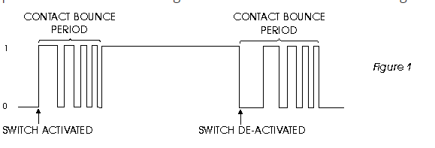
Switch bouncing
Kshitij Hemant Gurjar (SY M.Tech VLSI)
Prof. Y.M. Vaidya
Swapnil Phalke (SY M.Tech VLSI)
MAP Lab

Slide 8
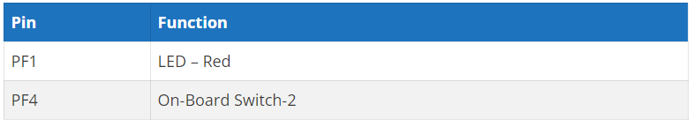
Controlling an LED with a push button using Tiva Launchpad
whenever a user presses the push button that is connected with the PF0 pin of TM4C123G6PM microcontroller, LED will turn on. Moreover, as soon as the user releases the push button, the LED turns off.
Kshitij Hemant Gurjar (SY M.Tech VLSI)
Prof. Y.M. Vaidya
Swapnil Phalke (SY M.Tech VLSI)
MAP Lab

Slide 9
Steps
Include Header File TM4C123GH6PM.h
GPIO Pins Clock Enable Register
GPIO Lock and Commit Registers
Pull-Up Resistor Register CR PUR
Direction Control Register DIR DEN
LAB 1 Introduction to TM4C123
Kshitij Hemant Gurjar (SY M.Tech VLSI)
Prof. Y.M. Vaidya
Swapnil Phalke (SY M.Tech VLSI)
MAP Lab

Slide 10
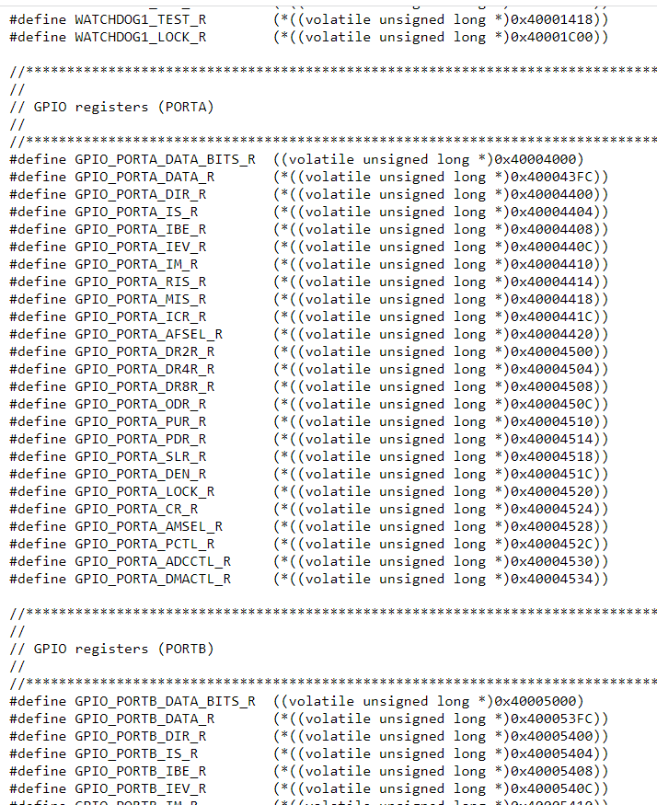
Include Header File
#include "TM4C123GH6PM.h"
Kshitij Hemant Gurjar (SY M.Tech VLSI)
Prof. Y.M. Vaidya
Swapnil Phalke (SY M.Tech VLSI)
MAP Lab

Slide 11
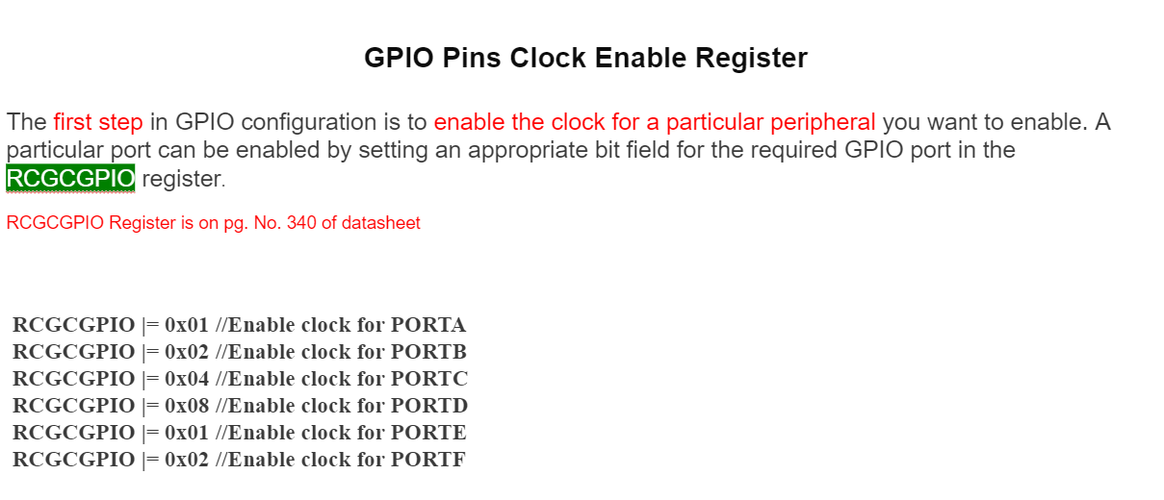
GPIO Pins Clock Enable Register
Kshitij Hemant Gurjar (SY M.Tech VLSI)
Prof. Y.M. Vaidya
Swapnil Phalke (SY M.Tech VLSI)
MAP Lab

Slide 12
GPIO Lock and Commit Registers
The next register is a GPIOLOCK register. It enables write access to GPIOCR register. In order to unlock access to the GPIOCR register, we must initialize the GPIOLOCK register with 0x4C4F.434B value.
Kshitij Hemant Gurjar (SY M.Tech VLSI)
Prof. Y.M. Vaidya
Swapnil Phalke (SY M.Tech VLSI)
MAP Lab

Slide 13
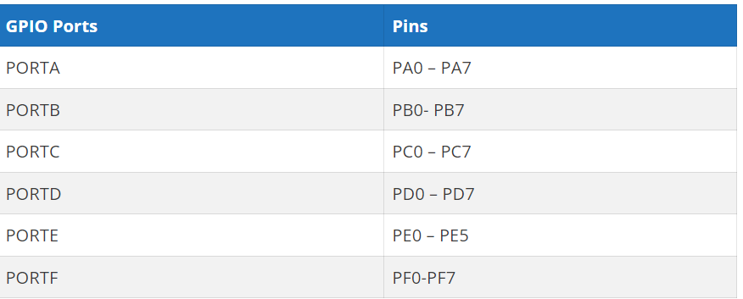
TM4C123GH6PM Microcontroller GPIO pins
TM4C123GH6PM belongs to the ARM Cortex M4 microcontroller series. It has six GPIO ports such as PORTA, PORTB, PORTC, PORTD, and PORTE. Each port has a different number of pins as given in this table.
LAB 1 Introduction to TM4C123
Kshitij Hemant Gurjar (SY M.Tech VLSI)
Prof. Y.M. Vaidya
Swapnil Phalke (SY M.Tech VLSI)
MAP Lab

Slide 14
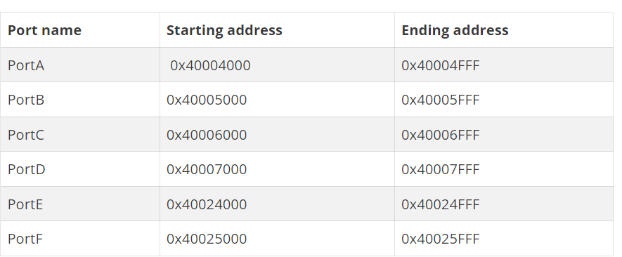
TM4C123GH6PM Microcontroller GPIO pins
All the address range of port A to port F are given in the table below. As you can see from this table, a total of 4K bytes of memory is allocated for each PORT. The reseason for this larger amount of memory for each port is due to many functions and special functions registers associated with each port of TM4C123G.
LAB 1 Introduction to TM4C123
Kshitij Hemant Gurjar (SY M.Tech VLSI)
Prof. Y.M. Vaidya
Swapnil Phalke (SY M.Tech VLSI)
MAP Lab

Slide 15
Revise Steps
Initialization of the main clock of the board
Enabling specific port registers of which the GPIO pins will be used
Initialization of GPIO port pins to either digital output or digital input .i.e. setting the direction pins
After that, the functionality of the port is selected if it is to be alternative or not (in this tutorial we are not using alternative functionality so skip it at this moment)
LAB 1 Introduction to TM4C123
few additional steps might be required. For instance, some of the GPIO pins are assigned special functionality by default, and to configure them as general-purpose input-output pins, we need to unlock or unmask the pin. It is possible to configure a GPIO pin as an alternative functionality multiplexing,
Kshitij Hemant Gurjar (SY M.Tech VLSI)
Prof. Y.M. Vaidya
Swapnil Phalke (SY M.Tech VLSI)
MAP Lab

Slide 16
Basic steps for TM4C123GH6PM launchpad configuration as a GPIO are listed below
1 - Clock configuration 2 - Data control configuration 3 - Mode control configuration 4 - Pad control configuration
Kshitij Hemant Gurjar (SY M.Tech VLSI)
Prof. Y.M. Vaidya
Swapnil Phalke (SY M.Tech VLSI)
MAP Lab

Slide 17
GPIO Pins Clock Enable Register
The first step in GPIO configuration is to enable the clock for a particular peripheral you want to enable. A particular port can be enabled by setting an appropriate bit field for the required GPIO port in the RCGCGPIO register.
RCGCGPIO Register is on pg. No. 340 of datasheet
RCGCGPIO |= 0x01 //Enable clock for PORTA
RCGCGPIO |= 0x02 //Enable clock for PORTB
RCGCGPIO |= 0x04 //Enable clock for PORTC
RCGCGPIO |= 0x08 //Enable clock for PORTD
RCGCGPIO |= 0x01 //Enable clock for PORTE
RCGCGPIO |= 0x02 //Enable clock for PORTF
Kshitij Hemant Gurjar (SY M.Tech VLSI)
Prof. Y.M. Vaidya
Swapnil Phalke (SY M.Tech VLSI)
MAP Lab

Slide 18
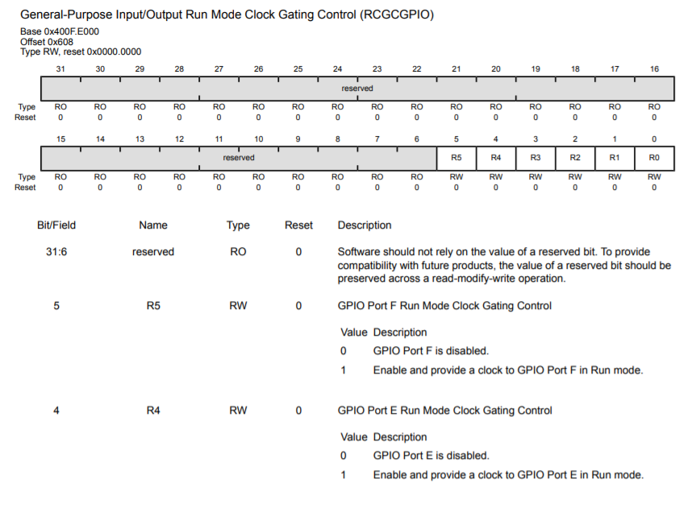
Kshitij Hemant Gurjar (SY M.Tech VLSI)
Prof. Y.M. Vaidya
Swapnil Phalke (SY M.Tech VLSI)
MAP Lab

Slide 19
TM4C123G GPIODATA Register
The GPIO port pins of TM4C123G are multiplexed with different peripherals such as digital I/O, PWM, serial communication, etc. But each pin can be used for only one functionality at a time. GPIODEN register is used to enable GPIO pins as digital input-output pins.
When the port pin is configured as GPIO pins, the GPIODATA register is used to read and write data on the registers. If the pin is configured as a digital output pin, the data written to the GPIODATA register reflects on the corresponding output pin.
Kshitij Hemant Gurjar (SY M.Tech VLSI)
Prof. Y.M. Vaidya
Swapnil Phalke (SY M.Tech VLSI)
MAP Lab

Slide 20
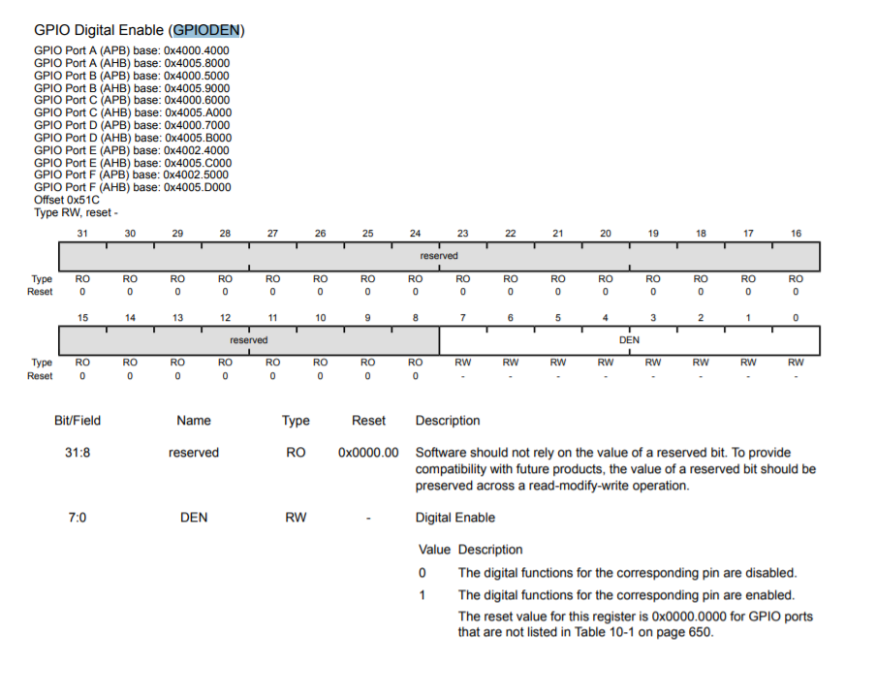
Pg 683
Kshitij Hemant Gurjar (SY M.Tech VLSI)
Prof. Y.M. Vaidya
Swapnil Phalke (SY M.Tech VLSI)
MAP Lab

Slide 21
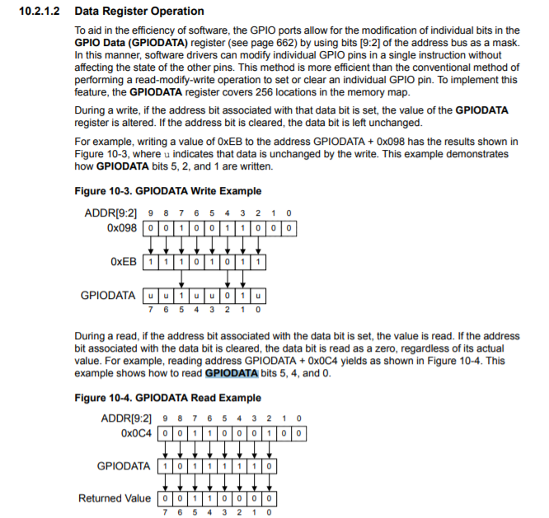
Pg 654
Kshitij Hemant Gurjar (SY M.Tech VLSI)
Prof. Y.M. Vaidya
Swapnil Phalke (SY M.Tech VLSI)
MAP Lab

Slide 22
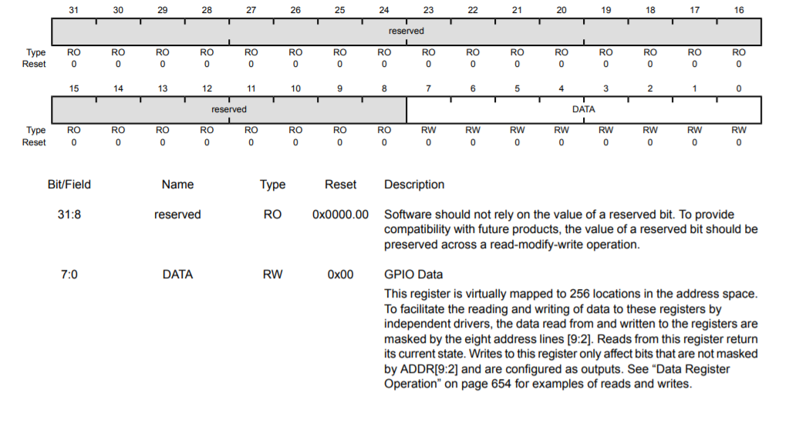
Pg 662
Kshitij Hemant Gurjar (SY M.Tech VLSI)
Prof. Y.M. Vaidya
Swapnil Phalke (SY M.Tech VLSI)
MAP Lab

Slide 23
TM4C123G GPIODIR Direction Control Register
A GPIODIR register decides, which pins of the PORT will be configured either as a digital input or a digital output. The individual configuration capability of each GPIO is applicable to other registers of the GPIO port pins.
If we want to enable a pin of a port as digital input-output the corresponding bit on the GPIODIR register should be set or reset. If we want to configure a particular pin of any port as a digital input pin, the corresponding e data direction bit should be cleared. Similarly, if we want to configure a particular pin of any port as a digital output pin, the corresponding data direction bit should be set to one.
Kshitij Hemant Gurjar (SY M.Tech VLSI)
Prof. Y.M. Vaidya
Swapnil Phalke (SY M.Tech VLSI)
MAP Lab

Slide 24
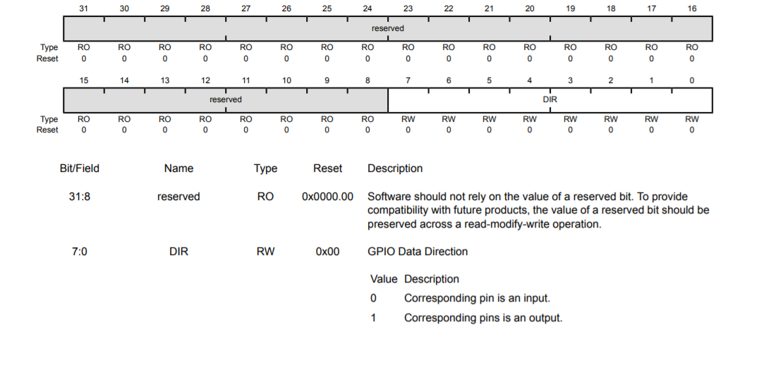
Pg 663
Kshitij Hemant Gurjar (SY M.Tech VLSI)
Prof. Y.M. Vaidya
Swapnil Phalke (SY M.Tech VLSI)
MAP Lab

Slide 25
GPIO PORTF base address = 0x4002 5000
GPIODEN Register offset address = 0x51c // page number 682 TM4C123GH6PM datasheet
physical address = 0x40025000+0x51C = 0x4002551C
Base address of PORTF = 0x40025000
Offset address of GPIODIR = 0x400 // // page number 663 TM4C123GH6PM datasheet
GPIODIR Physical address = 0x40025000+0x400 = 0x40025400
#define SYSCTL_RCGCGPIO_R (*(( volatile unsigned long *)0x400FE608 ) )
#define GPIO_PORTF_DATA_R (*(( volatile unsigned long *)0x40025038 ) )
#define GPIO_PORTF_DIR_R (*(( volatile unsigned long *)0x40025400 ) )
#define GPIO_PORTF_DEN_R (*(( volatile unsigned long *)0x4002551C ) )
int main ( void )
{
SYSCTL_RCGCGPIO_R |= 0x20; // Enable clock for PORTF
GPIO_PORTF_DEN_R = 0x0E; // Enable PORTF Pin1, 2 and 3 as a digital pins
GPIO_PORTF_DIR_R = 0x0E; // Configure ORTF Pin1, 2 and 3 digital output pins
while (1)
{
GPIO_PORTF_DATA_R |= 0x02; // turn on red LED
}
}
PORTF Base Address = 0x40025000
GPIODATA Registe offset address = is 0x000
GPIODATA Physical address = 0x40025000+0x608 = 0x40025000
Kshitij Hemant Gurjar (SY M.Tech VLSI)
Prof. Y.M. Vaidya
Swapnil Phalke (SY M.Tech VLSI)
MAP Lab

Slide 26
#include "TM4C123.h" // header files contains memory addresses listing
int main ( void )
{
SYSCTL->RCGCGPIO|= 0x20;
GPIOF->DIR = 0x02;
GPIOF->DEN = 0x02;
while (1){
GPIOF->DATA = 0x02; // turn on red LED
}
}
Kshitij Hemant Gurjar (SY M.Tech VLSI)
Prof. Y.M. Vaidya
Swapnil Phalke (SY M.Tech VLSI)
MAP Lab

Slide 27
int main(void)
{
SysCtlClockSet(SYSCTL_SYSDIV_5|SYSCTL_USE_PLL|SYSCTL_XTAL_16MHZ|SYSCTL_OSC_MAIN);
SysCtlPeripheralEnable(SYSCTL_PERIPH_GPIOF);
GPIOPinTypeGPIOOutput(GPIO_PORTF_BASE,GPIO_PIN_1|GPIO_PIN_2|GPIO_PIN_3);
while(1)
{
GPIOPinWrite(GPIO_PORTF_BASE,GPIO_PIN_1|GPIO_PIN_2|GPIO_PIN_3,0x02);
SysCtlDelay(5000000);
GPIOPinWrite(GPIO_PORTF_BASE,GPIO_PIN_1|GPIO_PIN_2|GPIO_PIN_3,0x04);
SysCtlDelay(5000000);
GPIOPinWrite(GPIO_PORTF_BASE,GPIO_PIN_1|GPIO_PIN_2|GPIO_PIN_3,0x08);
SysCtlDelay(5000000);
}
}
Kshitij Hemant Gurjar (SY M.Tech VLSI)
Prof. Y.M. Vaidya
Swapnil Phalke (SY M.Tech VLSI)
MAP Lab

Slide 28
Assignment 1 :
What is Embedded C Programming? How is Embedded C different from C language?
What is ISR?
What is Void Pointer in Embedded C and why is it used?
Why do we use the volatile keyword?
How will you use a variable defined in source file1 inside source file2?
LAB 1 Introduction to TM4C123
Kshitij Hemant Gurjar (SY M.Tech VLSI)
Prof. Y.M. Vaidya
Swapnil Phalke (SY M.Tech VLSI)
MAP Lab

Slide 29
Assignment 2 :
Go through all registers of GPIO
Read following functions:SysCtlPeripheralEnable,GPIOPinWrite,SysCtlDelay,SysCtlClockSet,GPIOPinTypeGPIOOutput
Compute XOR from 1 to n
LAB 1 Introduction to TM4C123
Input : n = 6
Output : 7
// 1 ^ 2 ^ 3 ^ 4 ^ 5 ^ 6 = 7
Input : n = 7
Output : 0
// 1 ^ 2 ^ 3 ^ 4 ^ 5 ^ 6 ^ 7 = 0
Kshitij Hemant Gurjar (SY M.Tech VLSI)
Prof. Y.M. Vaidya
Swapnil Phalke (SY M.Tech VLSI)
MAP Lab

